Slide 1
School of
Engineering and Computer Science
Te Kura Mātai Pūkaha, Pūrorohiko
CYBR 271 T2 2020 Secure Programming
Ian Welch, Harith Al-Sahaf
Set-UID & Privilege Elevation
Du, Wenliang, “Computer & Internet Security: A Hands-on Approach”, 2nd ed, 2019 (Chapter 1)

Slide 2
Where we are going
Up to now the focus has been on design
For the next four to five weeks we focus on real-world threats and countermeasures.
Starting with the world of C because many system services to be exploited are written in C or C++ (e.g. web servers).
Moving onto application level with a focus on web security.

Slide 3
Concept: Access control mechanisms
Discretionary Access Control (DAC):
Owner of object specifies who can access object (files/directories)
Control access on discretion of owner
Access privileges decided when file created
Ex: Windows, Linux, Mac, Unix
Mandatory Access Control (MAC):
system specifies which subjects(users/processes) can access which objects.
based on security labels mechanism
subjects are given clearance
objects are given security classification
Matches clearance of subject with classification of object.
Examples: secret, top secret, confidential

Slide 4
Access control mechanisms
Filesystem Access Control mechanisms:
ACLs
Role Based Access (RBAC) Can be Implemented as either DAC/MAC
ACL: Fine-grained discretionary access rights given to files & directories.
Specifies, which users/processes are granted access to objects.
Access rights tied with objects.
RBACs: System access on basis of authorization
specific roles are permitted to perform certain operations
access rights not tied to objects
Example: Roles created for various job functions.
Consider multiuser systems with users of different roles are accessing.

Slide 5
Unix users and root
Unix identifies users using a UID.
Users can be explicitly granted rights or permissions (more in a moment).
A special user called root exists and has the right to do anything on the system.
Also known as superuser.

Slide 6
Unix groups
Unix group: logical collection of users on a system.
All members of the same group share the same permissions.
Each group is independent of other groups.
Use the groups command to list the groups that you belong to on the system.

Slide 7
Unix others
When access control decisions are made, the rule evaluates whether the requestor is root, a specific user or a member of a group.
Some cases, requestor none of the above:
known as other or world
specify permissions to apply in this case

Slide 8
9 bit permission model
Command:
Output:
Permissions:
ls –l /etc
drwxr-xr-x 170 | root | root | 12288 | 2010-02-24 | 11:39 | /etc
drwxr-xr-x 170 | root | root | 12288 | 2010-02-24 | 11:39 | /etc
Three fields: rwx, r-x and r-x.

Slide 9
9 bit permission model
These fields are three characters each for:
File owner permissions (u)
File group permissions (g)
Other permissions (o), i.e., not part of both
owner or group)
Basic permissions:
r – if file is readable, otherwise –
w – if the file is writeable, otherwise –
x – if the file is executable or directory is searchable, otherwise –
 | r | w | x
u | 1 | 1 | 1
g | 1 | 0 | 1
o | 1 | 0 | 1
=7
=5
=5

Slide 10
9 bit permission model
drwxr-xr-x 170 root root 12288 2010-02-24 11:39 /etc
The next value is the size of the file or directory entry.
Followed by the user id (UID) and group id (GUID).
Doesn’t have to be the same (the higher permission wins).
What does this show?

Slide 11
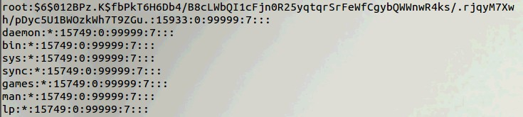
Need for Privileged Programs
Password Dilemma
Permissions of /etc/shadow File:
How would normal users change their password?

Slide 12
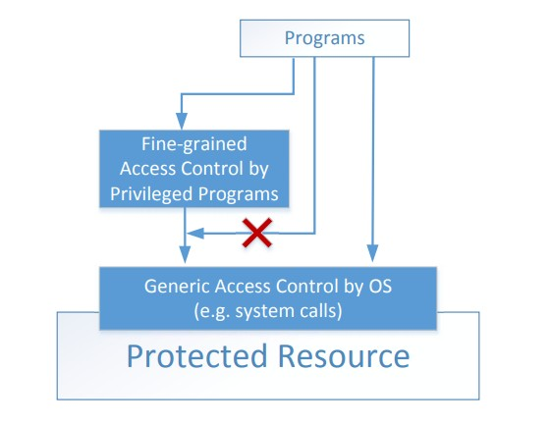
Two-Tier Approach
Implementing fine-grained access control in operating systems make OS over complicated.
OS relies on extension to enforce fine-grained access control
Privileged programs are such extensions

Slide 13
Types of Privileged Programs
Daemons
Computer program that runs in the background
Needs to run as root or other privileged users
Set-UID Programs
Widely used in UNIX systems
Program marked with a special bit

Slide 14

Superman Story
Power Suit
Superpeople: Directly give them the power
Issues: bad superpeople
Power Suit 2.0
Computer chip
Specific task
No way to deviate from pre-programmed task
Set-UID mechanism: A Power Suit mechanism implemented in Linux OS to provide fine-grained polices

Slide 15
Set-UID Concept
Allow user to run a program with the program owner’s privilege.
Allow users to run programs with temporary elevated privileges
Example: the passwd program
$ ls -l /usr/bin/passwd
-rwsr-xr-x 1 root root 41284 Sep 12
2012 /usr/bin/passwd

Slide 16
Set-UID Concept
Every process has two User IDs.
Real UID (RUID): Identifies real owner of process
Effective UID (EUID): Identifies privilege of a process
Access control is based on EUID
When a normal program is executed, RUID = EUID, they both equal to the ID of the user who runs the program
When a Set-UID is executed, RUID ≠ EUID. RUID still equal to the user’s ID, but EUID equals to the program owner’s ID.
If the program is owned by root, the program runs with the root privilege.

Slide 17


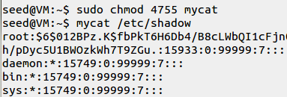
Turn a Program into Set-UID
Change the owner of a file to root:
Before Enabling Set-UID bit:
After Enabling the Set-UID bit :

Slide 18
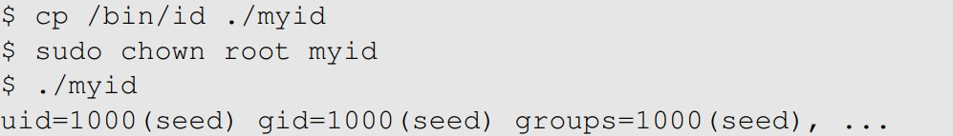
How it works
A Set-UID program is just like any other program, except that it has a special marking, which a single bit called Set-UID bit

Slide 19
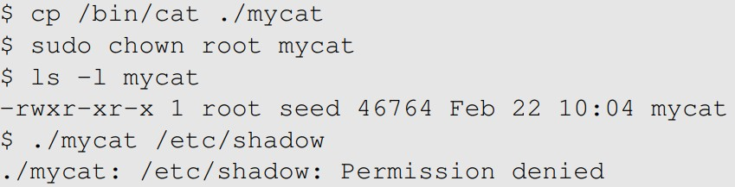

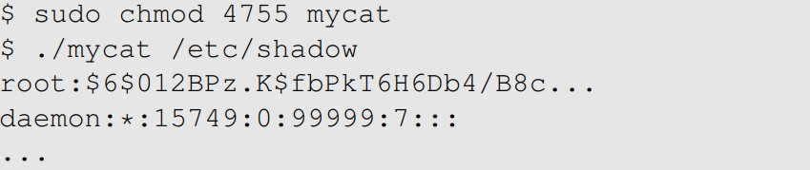
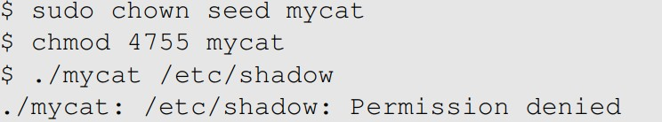
Example of Set UID
Not a privileged program
Become a privileged program
It is still a privileged program, but not the root privilege

Slide 20
How is Set-UID Secure?
Allows normal users to escalate privileges
This is different from directly giving the privilege (sudo command)
Restricted behavior – similar to superman designed computer chips
Unsafe to turn all programs into Set-UID
Example: /bin/sh
Example: vi

Slide 21
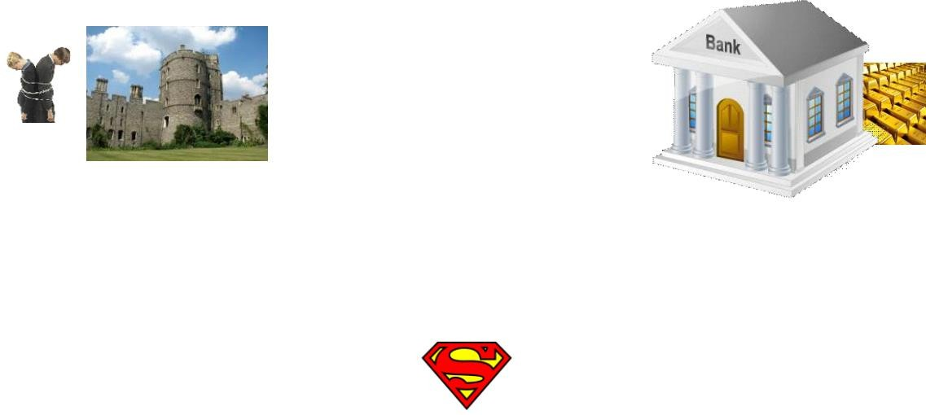
Attack on Superman
Cannot assume that user can only do whatever is coded
Coding flaws by developers
Superperson Mallroy
Fly north then turn left
How to exploit this code?
Superperson Malorie
Fly North and turn West
How to exploit this code?
1
2
Superperson is supposed to take
path 1, but they take path 2

Slide 22
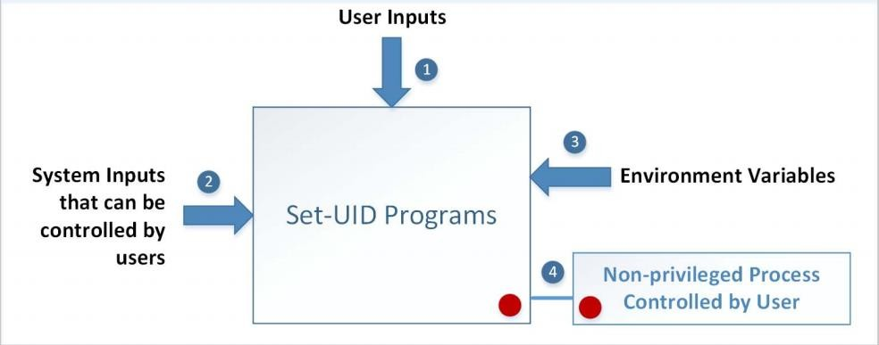
Attack Surfaces of Set-UID Programs

Slide 23
Attacks via User Inputs
User Inputs: Explicit Inputs
Buffer Overflow
Overflowing a buffer to run malicious code
Format String Vulnerability
Changing program behaviour using user inputs as format strings

Slide 24
Attacks via User Inputs
CHSH – Change Shell
Set-UID program with ability to change default shell programs
Shell programs are stored in /etc/passwd file
Issues
Failing to sanitize user inputs
Attackers could create a new root account
Attack

Slide 25
Attacks via System Inputs
System Inputs
Race Condition
Symbolic link to privileged file from a unprivileged file
Influence programs
Writing inside world writable folder

Slide 26
Attacks via Environment Variables
Behavior can be influenced by inputs that are not visible inside a program.
Environment Variables : These can be set by a user before running a program.

Slide 27
Attacks via Environment Variables
PATH Environment Variable
Used by shell programs to locate a command if the user does not provide the full path for the command
system(): call /bin/sh first
system(“ls”)
/bin/sh uses the PATH environment variable to locate “ls”
Attacker can manipulate the PATH variable and control how the “ls” command is found

Slide 28
Invoking Programs
Invoking external commands from inside a program
External command is chosen by the Set-UID program
Users are not supposed to provide the command (or it is not secure)
Attack:
Users are often asked to provide input data to the command.
If the command is not invoked properly, user’s input data may be turned into command name. This is dangerous.

Slide 29
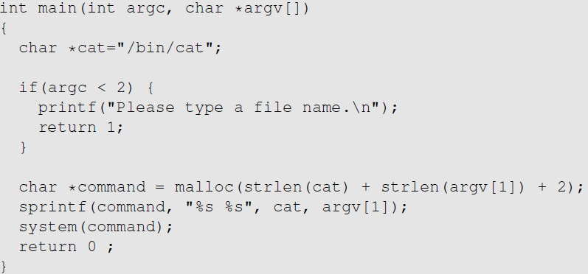
Invoking Programs : Unsafe Approach
The easiest way to invoke an external command is the system() function.
This program is supposed to run the /bin/cat program.
It is a root-owned Set-UID program, so the program can view all files, but it can’t write to any file.
Question: Can you use this program to run other command, with the root privilege?

Slide 30
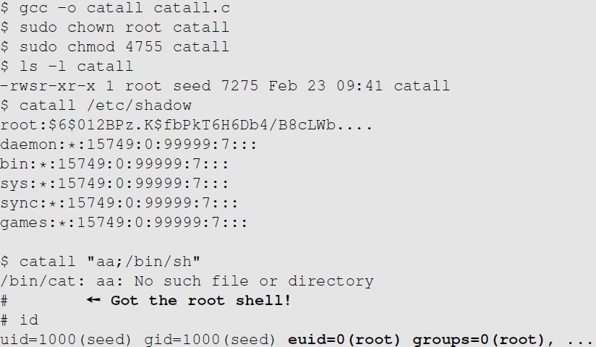
Invoking Programs : Unsafe Approach ( Continued)
Problem: Some part of the data becomes code (command name)
We can get a root shell with this input

Slide 31
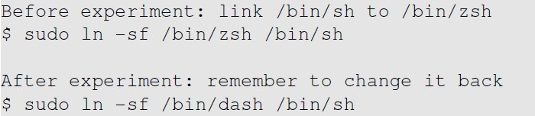
A Note
In Ubuntu 16.04, /bin/sh points to /bin/dash, which has a countermeasure
It drops privilege when it is executed inside a set-uid process
Therefore, we will only get a normal shell in the attack on the previous slide
Do the following to remove the countermeasure

Slide 32
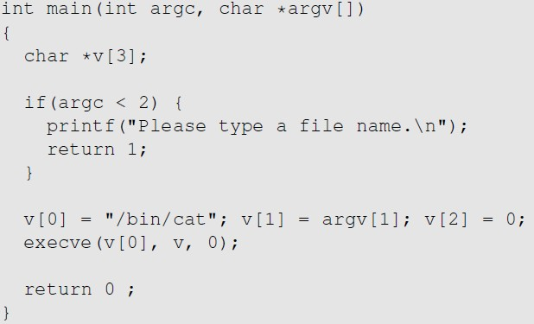
Invoking Programs Safely: using execve()
execve(v[0], v, 0)
Command name is provided here (by the program)
Input data are provided here (can be by user)
Why is it safe?
Code (command name) and data are clearly separated; there is no way for the user data to become code

Slide 33
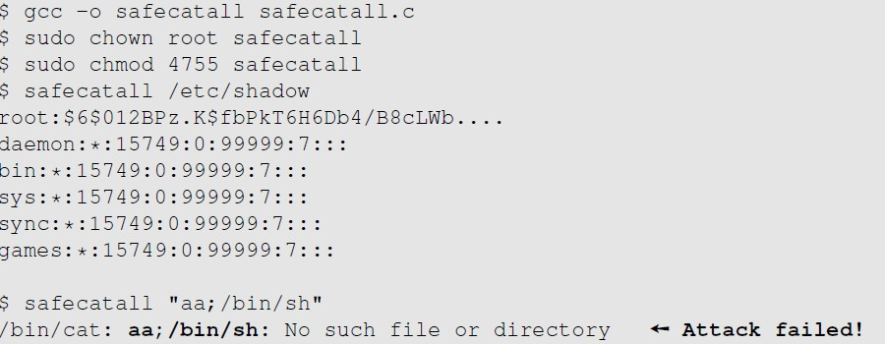
Invoking Programs Safely ( Continued)
The data are still treated as data, not code

Slide 34
Additional Consideration
Some functions in the exec() family behave similarly to execve(), but may not be safe
execlp(), execvp() and execvpe() duplicate the actions of the shell. These functions can be attacked using the PATH Environment Variable

Slide 35
Invoking External Commands in Other Languages
Risk of invoking external commands is not limited to C programs
We should avoid problems similar to those caused by the system() functions
Examples:
Perl: open() function can run commands, but it does so through a shell
Java: exec() method belonging to the Runtime class allows running a shell command
Process process = Runtime.getRuntime()
.exec(String.format("cmd.exe /c dir %s", homeDirectory));
Attack:
http://localhost/cgi-bin/list.cgi?dir=. & echo " anything"
Command executed on server : "cmd.exe /c dir . & echo " anything"

Slide 36
Principle of Isolation
Principle: Don’t mix code and data.
Attacks due to violation of this principle :
system() code execution
Cross Site Scripting
SQL injection
Buffer Overflow attacks

Slide 37
Principle of Least Privilege
A privileged program should be given the power which is required to perform it’s tasks.
Disable the privileges (temporarily or permanently) when a privileged program doesn’t need those.
In Linux, seteuid() and setuid() can be used to disable/discard privileges.
Different OSes have different ways to do that.

Slide 38
Summary
The need for privileged programs
How the Set-UID mechanism works
Security flaws in privileged Set-UID programs
Attack surface
How to improve the security of privileged programs

